Slide 1


Flight Delay Analysis
Mentor : Mr. Adam Shafi
Date : 25 September 2021

Slide 2

Project By
Sonali Mahamuni
Kalyani Bagal
Snehal Hatkar
Aanand Lele
Mayuresh Pathak

Slide 3
Business Objective
The objective of the data is to determine which flights would be
delayed and by how long, using different visualizations and finding
the insights on flight delays.

Slide 4
Project Flow
Week 1: Data Set Details
Week 2: Data Analysis
Week 3&4: Data Visualization
Week 5: Final Presentation

Slide 5
Data Set Details
Variable | Description
Year | Year of the Flight Trip
Month | Month of the Flight Trip
Day | Day of the Flight Trip
DAY_OF_WEEK | Day of week of the Flight Trip
AIRLINE | Airline Identifier
FLIGHT_NUMBER | Flight Identifier
TAIL_NUMBER | Aircraft Identifier
ORIGIN_AIRPORT | Starting Airport
DESTINATION_AIRPORT | Destination Airport
SCHEDULED_DEPARTURE | Planned Departure Time
DEPARTURE_TIME | WHEEL_OFF - TAXI_OUT
DEPARTURE_DELAY | Total Delay on Departure
TAXI_OUT | The time duration elapsed between departure from the origin airport gate and wheels off
WHEELS_OFF | The time point that the aircraft's wheels leave the ground
SCHEDULED_TIME | Planned time amount needed for the flight trip

Slide 6
ELAPSED_TIME | AIR_TIME+TAXI_IN+TAXI_OUT
AIR_TIME | The time duration between wheels_off and wheels_on time
DISTANCE | Distance between two airports
WHEELS_ON | The time point that the aircraft's wheels touch on the ground
TAXI_IN | The time duration elapsed between wheels-on and gate arrival at the destination airport
SCHEDULED_ARRIVAL | Planned arrival time
ARRIVAL_TIME | WHEELS_ON+TAXI_IN
ARRIVAL_DELAY | ARRIVAL_TIME-SCHEDULED_ARRIVAL
DIVERTED | Aircraft landed on airport that out of schedule
CANCELLED | Flight Cancelled (1 = cancelled)
CANCELLATION_REASON | Reason for Cancellation of flight: A - Airline/Carrier; B - Weather; C - National Air System; D - Security
AIR_SYSTEM_DELAY | Delay caused by air system
SECURITY_DELAY | Delay caused by security
AIRLINE_DELAY | Delay caused by the airline
LATE_AIRCRAFT_DELAY | Delay caused by aircraft
WEATHER_DELAY | Delay caused by weather

Slide 7
Data Types
Variable | Datatype | Missing Values
Year | Integer | 0
Month | Integer | 0
Day | Integer | 0
DAY_OF_WEEK | Integer | 0
AIRLINE | String | 0
FLIGHT_NUMBER | Integer | 0
TAIL_NUMBER | String | 167
ORIGIN_AIRPORT | String | 0
DESTINATION_AIRPORT | String | 0
SCHEDULED_DEPARTURE | Integer | 0
DEPARTURE_TIME | Integer | 2301
DEPARTURE_DELAY | Integer | 2301
TAXI_OUT | Integer | 2374
WHEELS_OFF | Integer | 2374
SCHEDULED_TIME | Integer | 0

Slide 8
ELAPSED_TIME | Integer | 2618
AIR_TIME | Integer | 2618
DISTANCE | Integer | 0
WHEELS_ON | Integer | 2445
TAXI_IN | Integer | 2445
SCHEDULED_ARRIVAL | Integer | 0
ARRIVAL_TIME | Integer | 2445
ARRIVAL_DELAY | Integer | 2618
DIVERTED | Integer | 0
CANCELLED | Integer | 0
CANCELLATION_REASON | String | 97893
AIR_SYSTEM_DELAY | Integer | 65589
SECURITY_DELAY | Integer | 65589
AIRLINE_DELAY | Integer | 65589
LATE_AIRCRAFT_DELAY | Integer | 65589
WEATHER_DELAY | Integer | 65589

Slide 9
Details
MONTH
1 | January
2 | February
3 | March
TIME
Time Format for data is 24Hrs From 0000Hrs to 2359Hrs
DEPARTURE
Before Time | Negative Numbers
On Time | Zero
Delay | Positive Numbers
DAY_OF_WEEK
1 | Monday
2 | Tuesday
3 | Wednesday
4 | Thursday
5 | Friday
6 | Saturday
7 | Sunday
CANCELLATION_REASON
A | Airline/Carrier
B | Weather
C | National Air System
D | Security

Slide 10

Week 2

Slide 11
AIRLINE | TOTAL FLIGHT | DEPARTURE_DELAY | ARRIVAL_DELAY | DEPARTURE BEFORE | ARRIVAL BEFORE | DEPARTURE ON TIME | ARRIVAL ON TIME | AIR_SYSTEM_DELAY | SECURITY_DELAY | AIRLINE_DELAY | LATE_AIRCRAFT_DELAY | WEATHER_DELAY | Cancel | Flown
AA | 9463 | 5334 | 5706 | 3501 | 3316 | 372 | 167 | 2183 | 19 | 2079 | 2270 | 329 | 261 | 9202
AS | 2841 | 1029 | 1161 | 1650 | 1604 | 159 | 69 | 358 | 1 | 244 | 205 | 42 | 4 | 2837
B6 | 4701 | 2248 | 2541 | 2199 | 2004 | 238 | 125 | 1099 | 8 | 991 | 943 | 37 | 17 | 4684
DL | 13196 | 5626 | 5002 | 6463 | 7942 | 1089 | 221 | 1548 | 1 | 1479 | 1094 | 337 | 19 | 13177
EV | 10835 | 5312 | 6053 | 4680 | 4113 | 438 | 204 | 2524 | 0 | 2125 | 2305 | 161 | 421 | 10414
F9 | 1564 | 1012 | 1099 | 467 | 389 | 44 | 31 | 614 | 0 | 462 | 459 | 36 | 44 | 1520
HA | 1334 | 565 | 762 | 708 | 511 | 59 | 58 | 5 | 3 | 307 | 238 | 26 | 2 | 1332
MQ | 6317 | 3554 | 4096 | 1652 | 1254 | 248 | 76 | 2281 | 12 | 1430 | 1979 | 671 | 880 | 5437
NK | 1820 | 1152 | 1190 | 595 | 581 | 56 | 27 | 826 | 0 | 4 | 0 | 0 | 18 | 1802
OO | 10508 | 5067 | 5842 | 4562 | 3999 | 484 | 221 | 2060 | 14 | 1555 | 2370 | 165 | 418 | 10090
UA | 8444 | 5878 | 4873 | 2121 | 3322 | 387 | 164 | 1645 | 0 | 2133 | 1495 | 273 | 65 | 8379
US | 7004 | 2959 | 3544 | 3630 | 3202 | 357 | 180 | 1354 | 28 | 1074 | 784 | 135 | 62 | 6942
VX | 1041 | 412 | 422 | 545 | 590 | 82 | 27 | 73 | 3 | 94 | 58 | 50 | 2 | 1039
WN | 21218 | 14025 | 12908 | 5819 | 7635 | 1207 | 437 | 3703 | 23 | 5873 | 6370 | 253 | 180 | 21038

Slide 12

Week 3

Slide 13

Insights
Departure and Arrival Delay For Different Airlines And Airports.
Delay Information by Location of Airports Across the US.
Delay By the difference time frames such as week of the month and day of week
Fight delays by the different reasons such as Late Aircraft Delay, Airline Delay, Air System Delay, Airline Delay, Weather Delay, Security Delay etc..

Slide 14
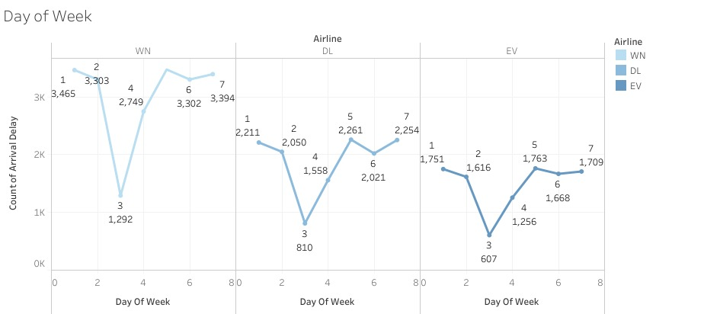
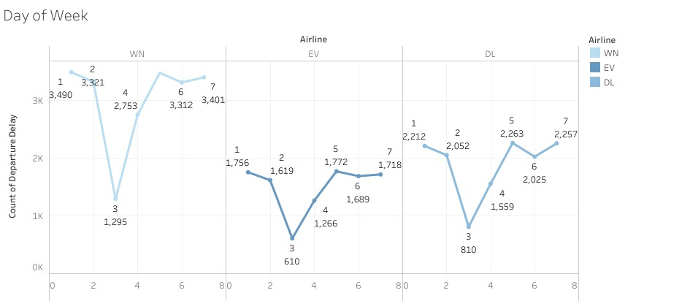
Delays By Day
On day 5 there are maximum delay and on day 3 minimum delays are happen

Slide 15

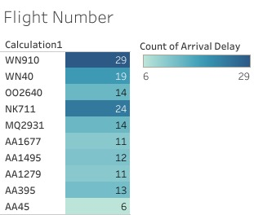
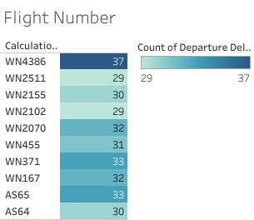

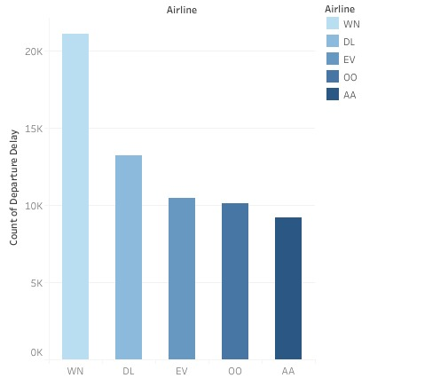
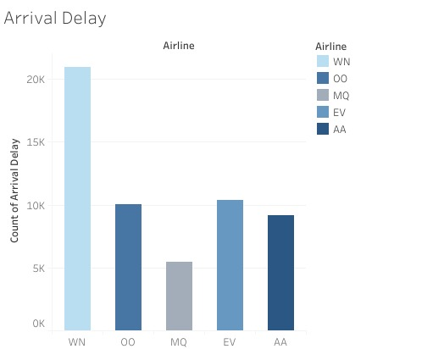
Air Carrier Recommendation
AA had fewer delayed flights compared to the other airlines

Slide 16
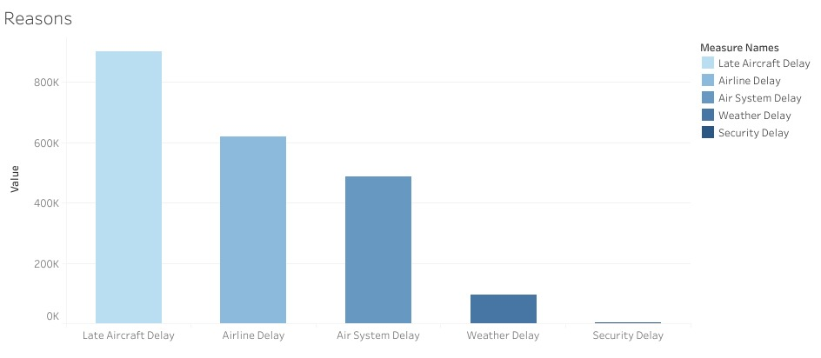
Reasons For delays
Mostly delays caused by late aircraft

Slide 17
Week 4

Slide 18
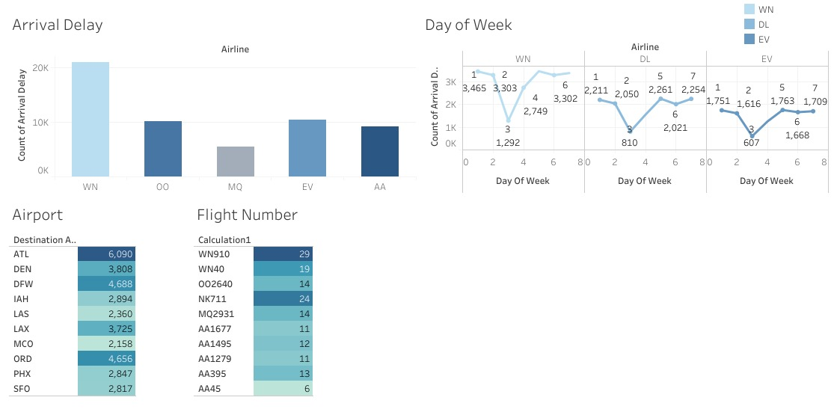
Final Dashboard

Slide 19
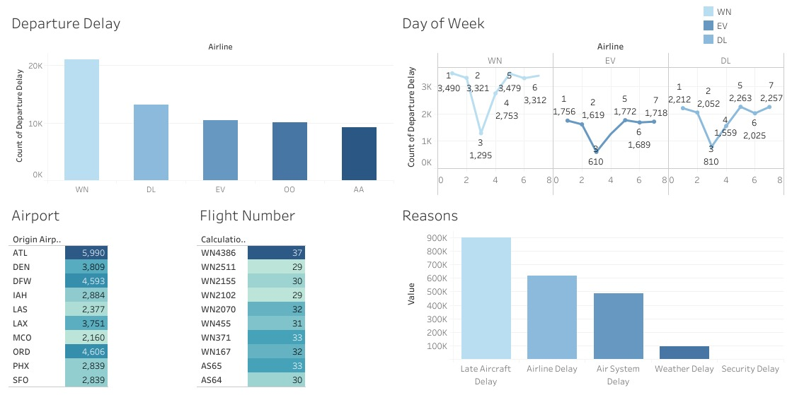

Slide 20

Conclusion
According to all this Analysis using Tableau BI tool We concluded that maximum delayed happened because of Late Aircraft delay that affected on Departure and Arrival time of flights of 14 different Airlines from US department of transportation. Which tracks on time performance of domestic flights operated by large Air Carriers.

Slide 21
Thank You

